Slide 1
Lab Exercise: 7
Implementation of unification and resolution

Slide 2
Unification
Unification is a process of making two different logical atomic expressions identical by finding a substitution.
Unification depends on the substitution process.
It takes two literals as input and makes them identical using substitution.
Let Ψ₁ and Ψ₂ be two atomic sentences and 𝜎 be a unifier such that, Ψ₁𝜎 = Ψ₂𝜎, then it can be expressed as UNIFY(Ψ₁, Ψ₂).

Slide 3
Conditions for Unification
Following are some basic conditions for unification:
Predicate symbol must be same, atoms or expression with different predicate symbol can never be unified.
Number of Arguments in both expressions must be identical.
Unification will fail if there are two similar variables present in the same expression.

Slide 4
Unification Algorithm
Step.1: If Ψ1 or Ψ2 is a variable or constant, then:
a) If Ψ1 or Ψ2 are identical, then return NIL.
b) Else if Ψ1is a variable,
a. then if Ψ1 occurs in Ψ2, then return FAILURE
b. Else return { (Ψ2/ Ψ1)}.
c) Else if Ψ2 is a variable,
a. If Ψ2 occurs in Ψ1 then return FAILURE,
b. Else return {( Ψ1/ Ψ2)}.
d) Else return FAILURE.
Step.2: If the initial Predicate symbol in Ψ1 and Ψ2 are not same, then return FAILURE.

Slide 5
Unification Algorithm
Step. 3: IF Ψ1 and Ψ2 have a different number of arguments, then return FAILURE.
Step. 4: Set Substitution set(SUBST) to NIL.
Step. 5: For i=1 to the number of elements in Ψ1.
a) Call Unify function with the ith element of Ψ1 and ith element of Ψ2, and put the result into S.
b) If S = failure then returns Failure
c) If S ≠ NIL then do,
a. Apply S to the remainder of both L1 and L2.
b. SUBST= APPEND(S, SUBST).
Step.6: Return SUBST.

Slide 6
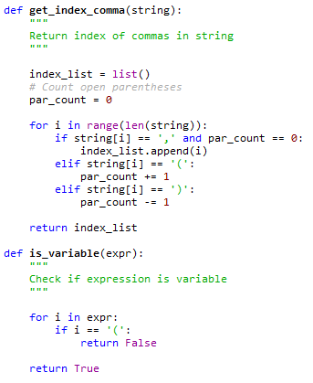
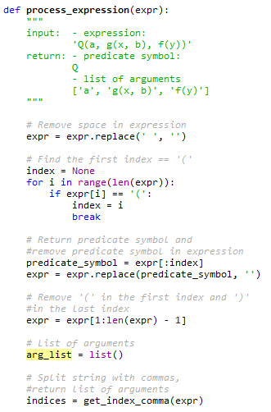
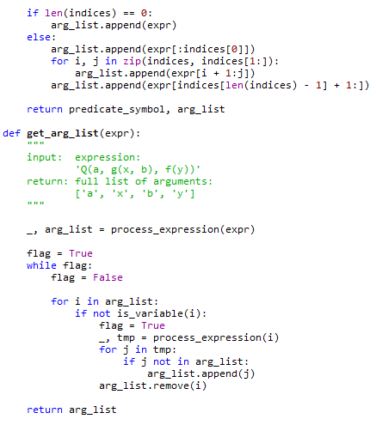
Code

Slide 7
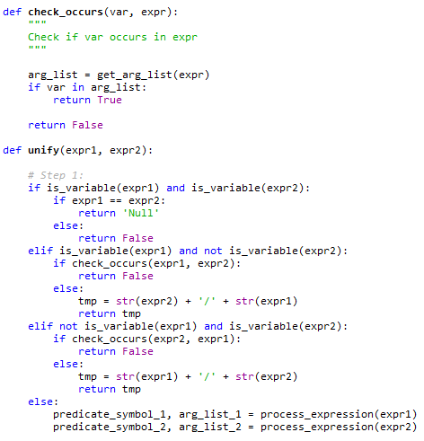
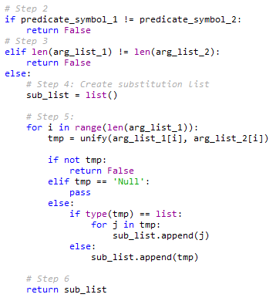
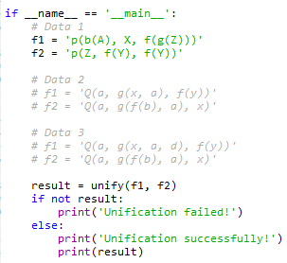
Code

Slide 8
Code
Output:

Slide 9
Resolution
Resolution is a theorem proving technique that proceeds by building refutation proofs, i.e., proofs by contradictions. It was invented by a Mathematician John Alan Robinson in the year 1965.
Resolution is used, if there are various statements are given, and we need to prove a conclusion of those statements. Unification is a key concept in proofs by resolutions. Resolution is a single inference rule which can efficiently operate on the conjunctive normal form or clausal form.
Clause: Disjunction of literals (an atomic sentence) is called a clause. It is also known as a unit clause.
Conjunctive Normal Form: A sentence represented as a conjunction of clauses is said to be conjunctive normal form or CNF.

Slide 10
Steps for Resolution
Conversion of facts into first-order logic.
Convert FOL statements into CNF
Negate the statement which needs to prove (proof by contradiction)
Draw resolution graph (unification)

Slide 11
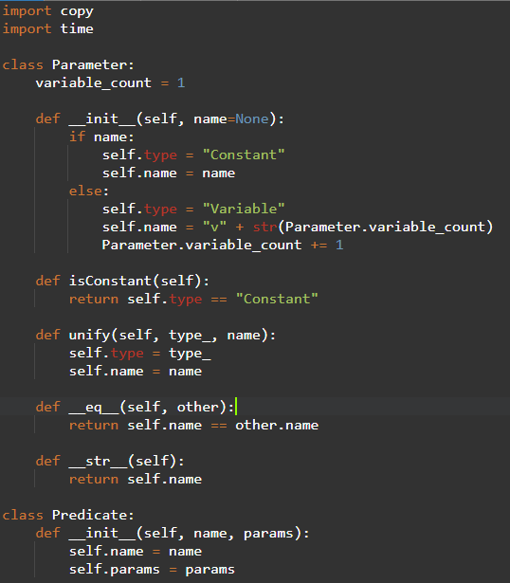
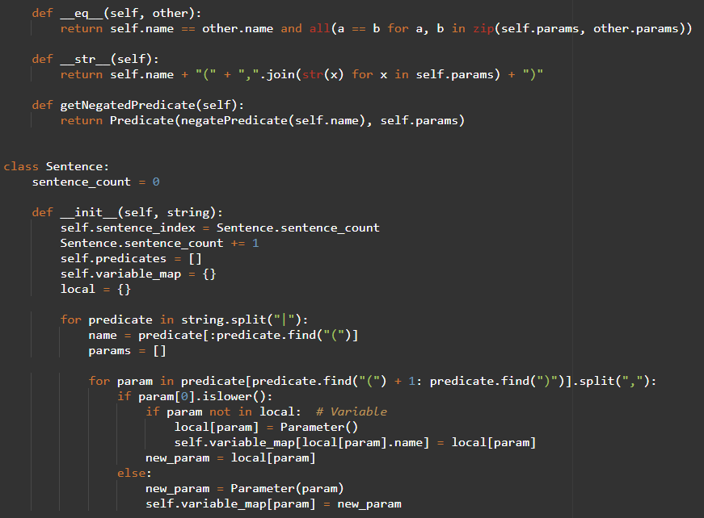
Code

Slide 12
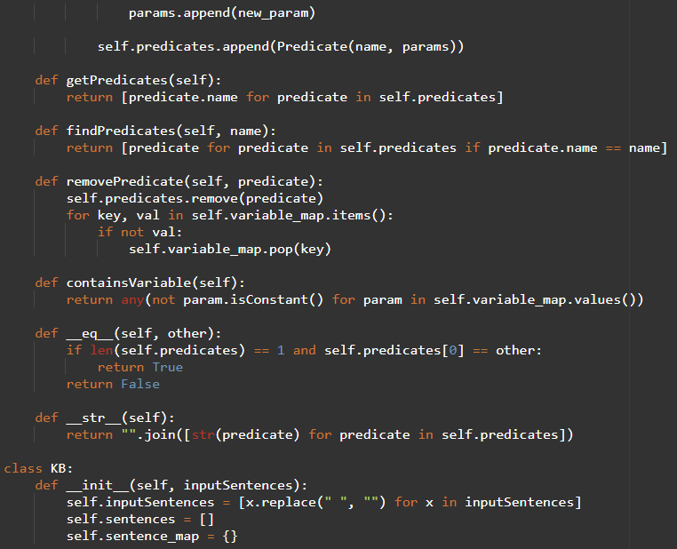
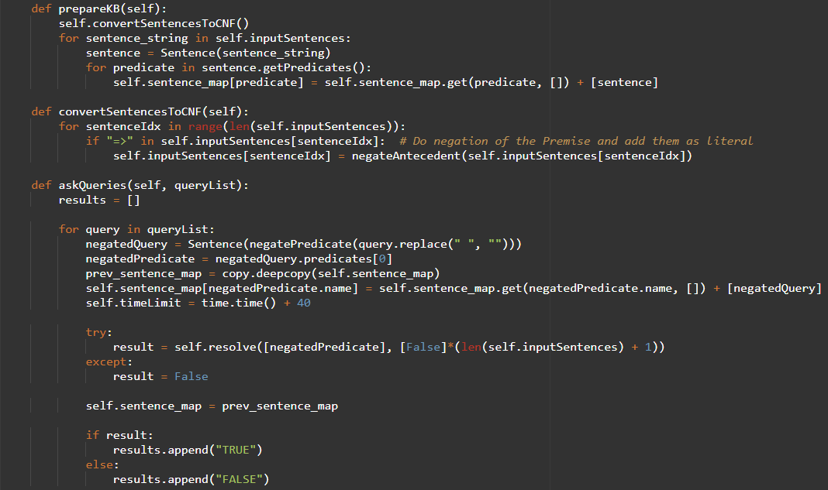
Code

Slide 13
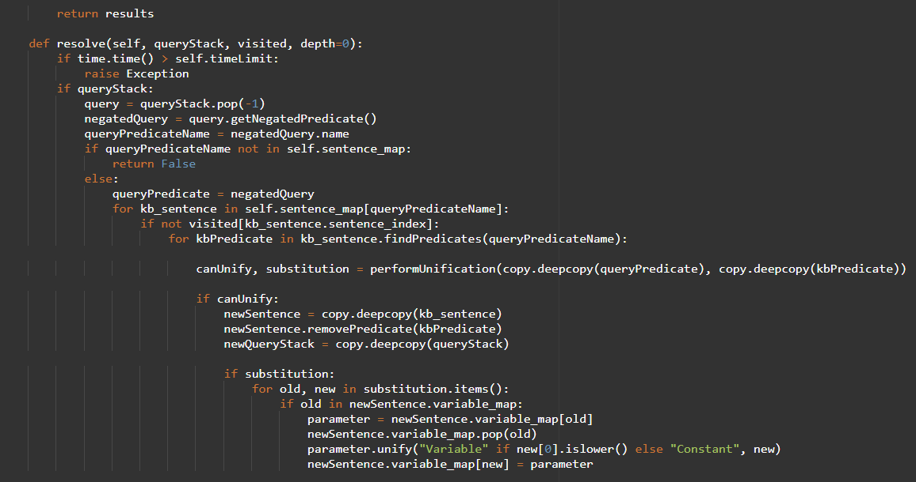
Code

Slide 14
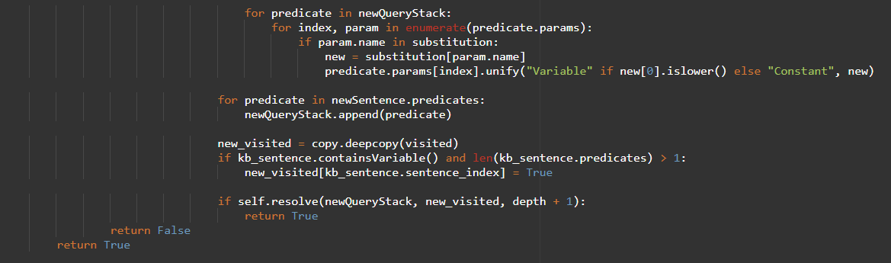
Code

Slide 15
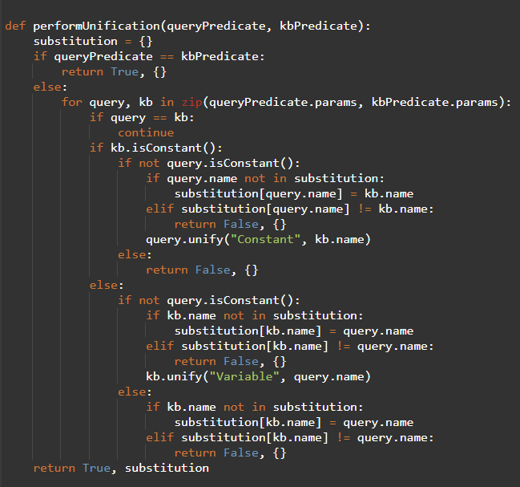
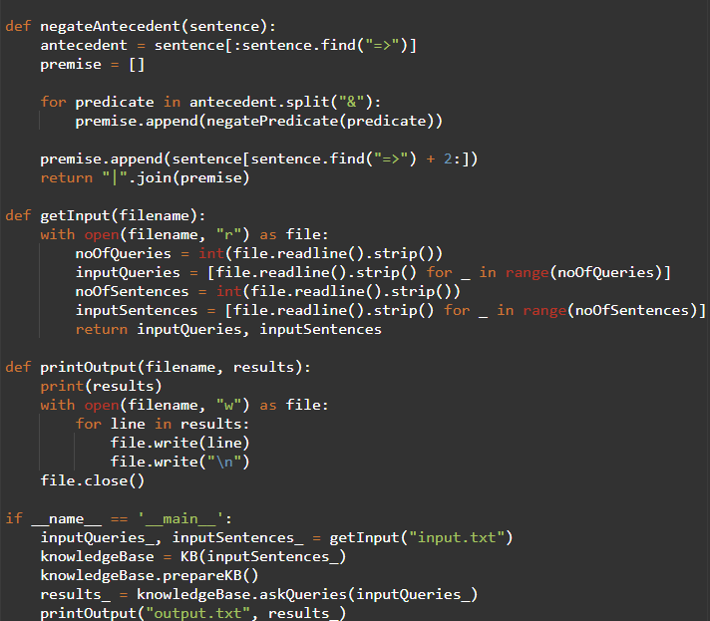
Code

Slide 16
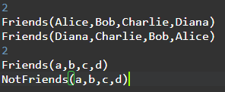
Code
Input:
Output:

Slide 17
Thank You
VIVEK BURUGUDDA RA1911003010316
HARSHIL AGARWAL RA1911003010325
RITESH RAI RA1911003010333
PUNEET SHARMA RA1911003010331
PRAKHAR VIJAY RA1911003010337

